Slide 1
Programming in K8s
Frameworks and good practices

Slide 2
Why programming in K8s
The main reason is to extend Kubernetes functionalities. There are a few main extension points:
Client plugins (e.g. extending kubectl)
API Access extensions
API extensions
Scheduling extensions
CRDs and Controllers (new APIs)
Network Plugins
Device Plugins
Storage Plugins
More info official documentation

Slide 3
How can I program in Kubernetes?
Using client libraries
Using appropriate framework which can easy and speed up the development process. Among the most common ones there are:
Kubebuilder
Operator SDK

Slide 4
Kubebuilder
Kubebuilder is an tool for rapidly building and publishing Kubernetes APIs in Go.
It builds on top of the canonical techniques used to build the core Kubernetes APIs to provide simple abstractions that reduce boilerplate and toil.
Who is it for?
Users of Kubernetes
Kubernetes extensions developers
Go developers
More info on the official documentation

Slide 5
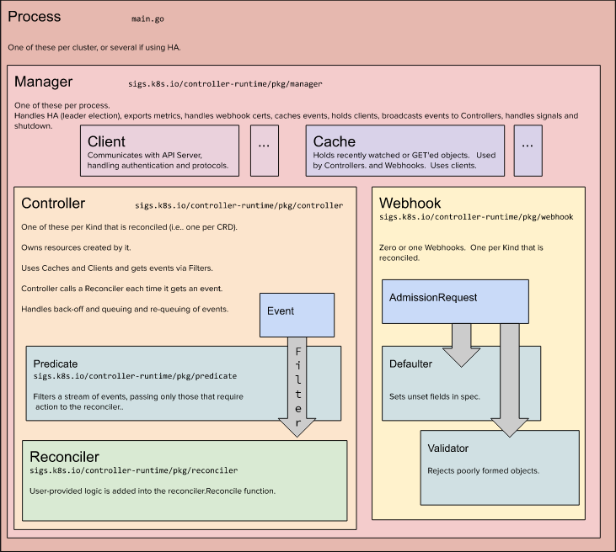
Kubebuilder Architecture

Slide 6
Operator SDK
The Operator SDK is a tool that provides the facilities to build, test, and package Operators.
Yes but.. What is an Operator?

Slide 7
Operators in K8s
Software extensions to Kubernetes that make use of custom resources to manage applications and their components.
The operator pattern aims to capture the key aim of a human operator who is managing a service or set of services.
The operator pattern captures how you can write code to automate a task beyond what Kubernetes itself provides.
More info on the official documentation

Slide 8
Operator SDK cont'd
The Operator SDK is a framework that uses the controller-runtime library to make writing operators easier by providing:
High level APIs and abstractions to write the operational logic more intuitively
Tools for scaffolding and code generation to bootstrap a new project fast
Extensions to cover common Operator use cases
Different Operator "types":
Helm-based
Ansible-based
Go-based

Slide 9
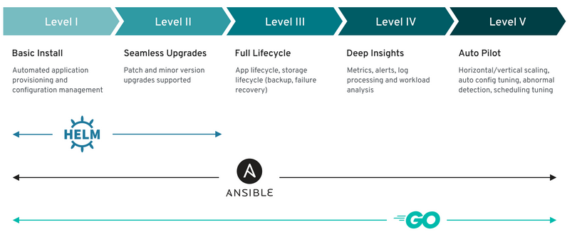
Operator types and capability levels in Operator SDKs
More info on the official documentation

Slide 10
Kubebuilder vs Operator SDK
Kubebuilder
Operator SDK
Origin: Kubebuilder was developed by the Kubernetes community and is an open-source project hosted by the Cloud Native Computing Foundation (CNCF).
Philosophy: Kubebuilder takes a more low-level approach, providing a framework for building custom controllers and Operators. It relies heavily on writing Go code to define your custom resources and controllers. This allows for a high degree of customization and flexibility but can also involve more manual coding.
Origin: Operator SDK is also an open-source project but is developed by Red Hat. It's now part of the Operator Framework, which aims to make it easier to build, test, and package Kubernetes Operators.
Philosophy: Operator SDK takes a higher-level, more opinionated approach by providing a set of pre-built templates, scaffolding, and libraries for developing Operators. It allows developers to define custom resources and controllers using YAML manifests and automates a significant portion of the development process.

Slide 11
Kubebuilder vs Operator SDK cont'd
Kubebuilder
Operator SDK
Use Cases: Kubebuilder is well-suited for experienced Kubernetes developers who want fine-grained control over their Operators and are comfortable writing Go code. It's a good choice if you have complex requirements or want to implement unique logic that isn't easily accommodated by higher-level abstractions.
When to Use: Choose Kubebuilder when you need a high level of control, customization, and are comfortable with Go programming. It's a good fit for building Operators for complex or unique applications.
Use Cases: Operator SDK is a good choice for developers who want to streamline Operator development, reduce boilerplate code, and follow best practices without getting deeply into Go coding. It's particularly useful when building Operators for applications that have common deployment and management patterns.
When to Use: Choose Operator SDK when you want to accelerate Operator development, follow established best practices, and prefer working with YAML manifests for custom resources. It's a good fit for many standard application deployments on Kubernetes.

